Slide 1




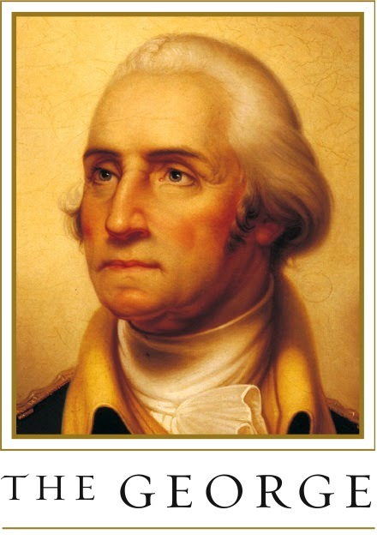

Group #11
START HERE
Covid Risk Dashboard
Present by: Ziyan Guo, Zihao Li, Sihan Adi, Weihang Chen

Slide 2

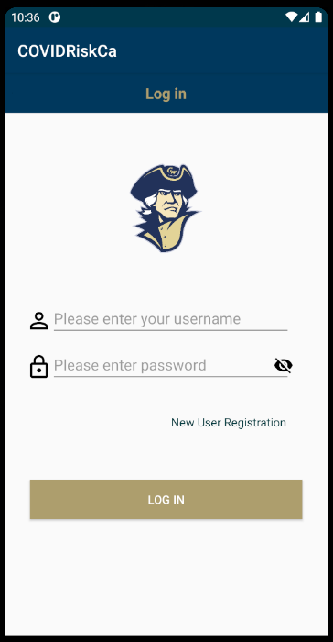
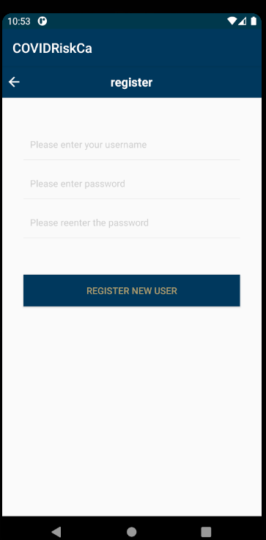
Home page:
register page:
New user must registration first to create a account to use this app
Because it involves personal privacy information, the password input is protected.
After the login you will jump to the information collection page
Group 11

Slide 3
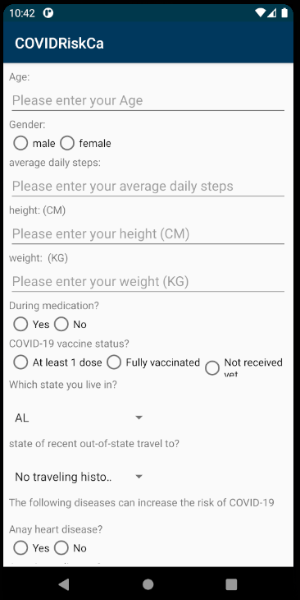
information collection page :
On this page you can record all information related to Covid
Any changes and differences in information may change your likelihood of being COVID-positive
These information records contain most of the CDC website guidance on the factors most likely to change the risk around you
Group 11

Slide 4
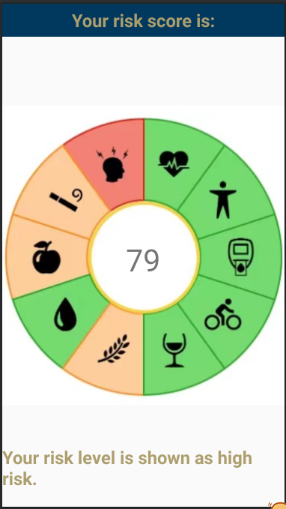
Result page :
In this interface you can know your current risk score, the higher the score, the more likely you are to be COVID-positive
Group 11

Slide 5
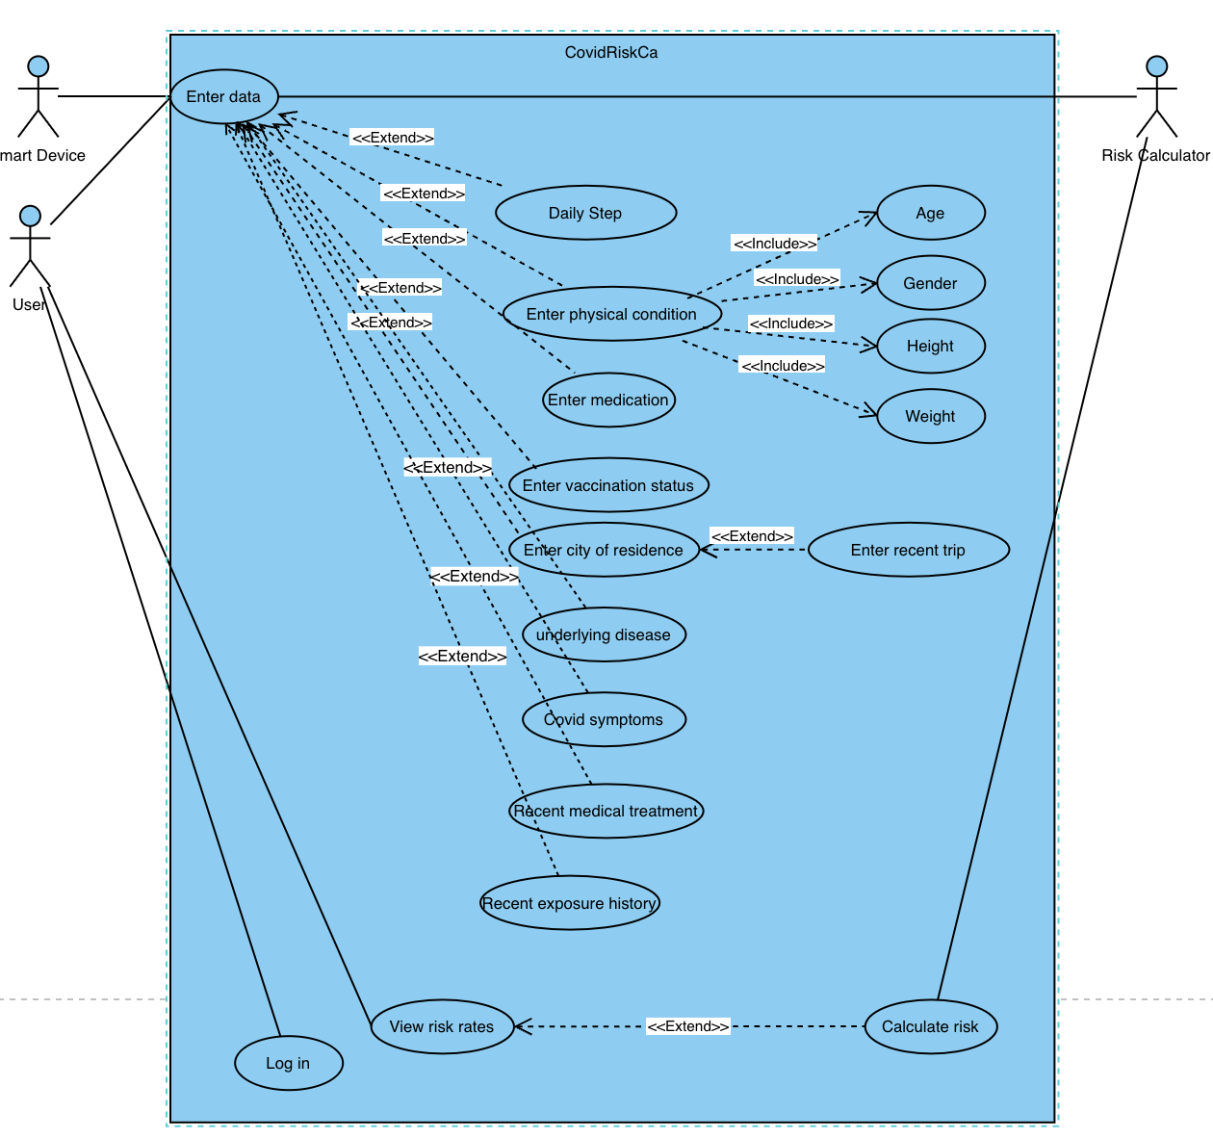
Use Case Diagram
Group 11

Slide 6
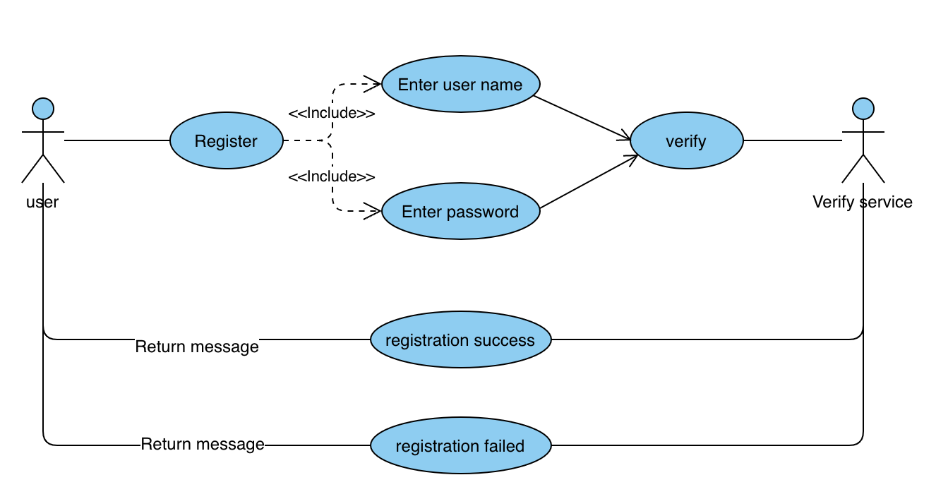
Use Case Diagram
Register
Group 11

Slide 7
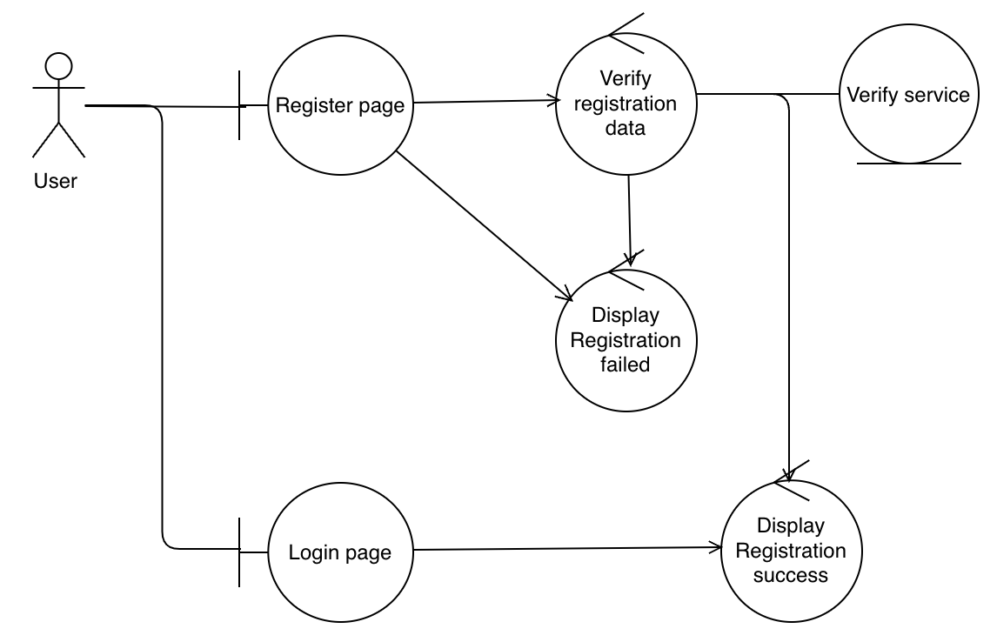
Robustness Diagram
Register
Group 11

Slide 8
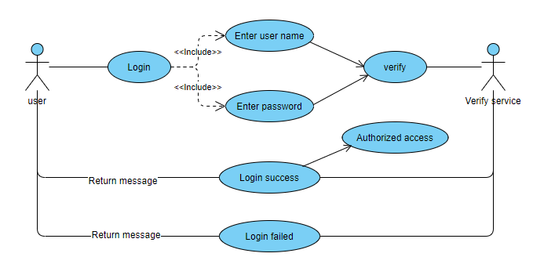
Use Case Diagram
Login in
Group 11

Slide 9
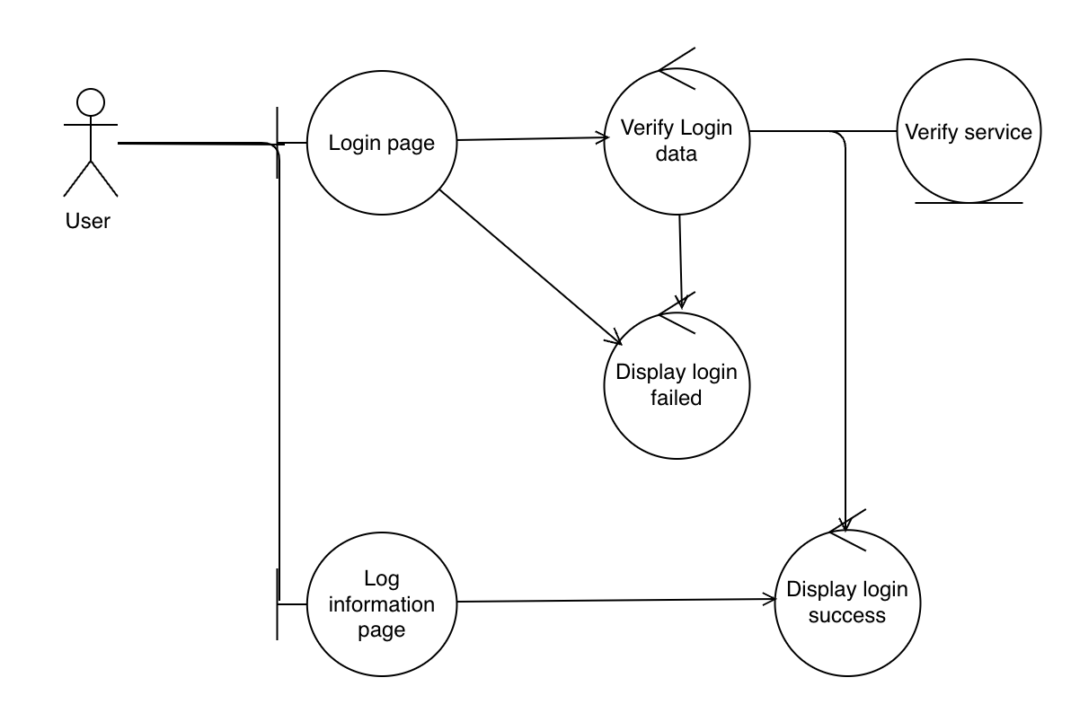
Robustness Diagram
Login in
Group 11

Slide 10
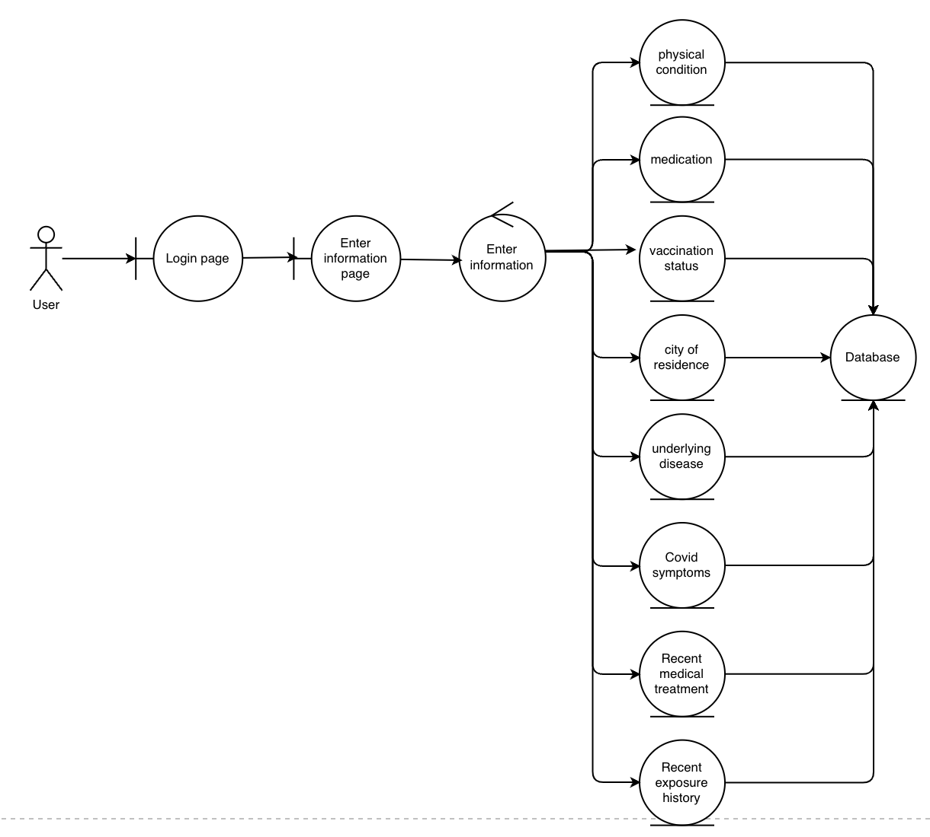
Robustness Diagram
Enter information
Group 11

Slide 11
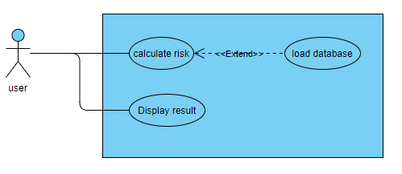
Use Case Diagram
Calculate Risk
Group 11

Slide 12
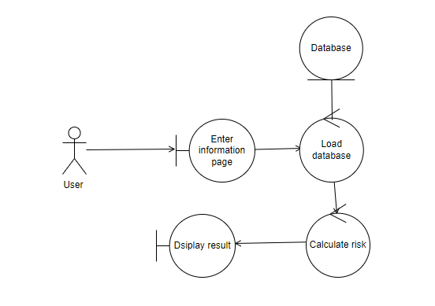
Robustness Diagram
Calculate Risk
Group 11

Slide 13
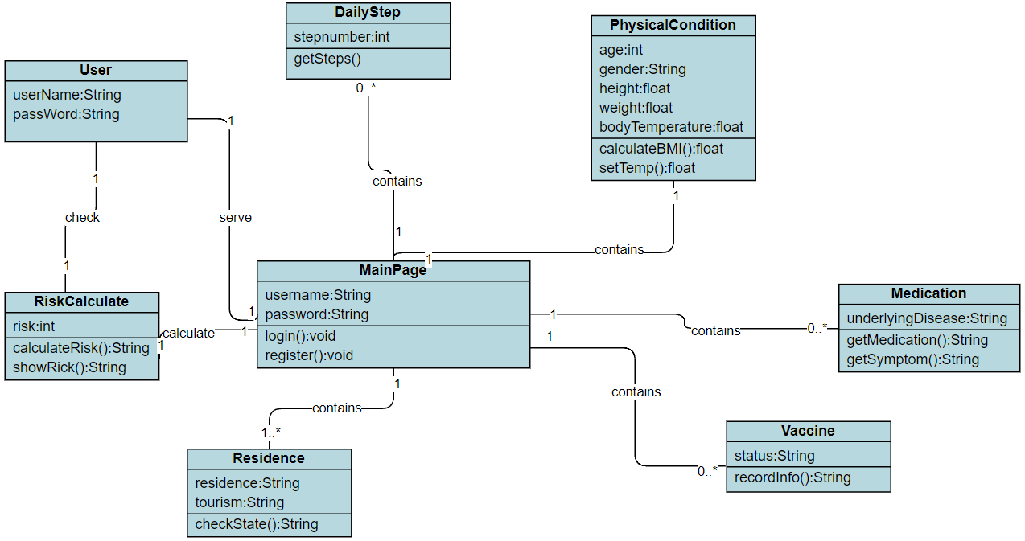
Domain Model
Group 11

Slide 14
Group #11
THANK YOU
Present by: Ziyan Guo, Zihao Li, Sihan Adi,

